Slide 1

WELCOME
CCNU SUMMER SCHOOL PROJECT
demo
used tech
DONE BY GROUP 1
Chieu Vien Nguyen
Muhammad Ali
Megha Mohan
Shihui Liu
Sujith Puzhakkal Sundarakshan
future scope
support
students
about
admin
features
Notes:
Good morning all ! This is group 1 here. Thankyou for joining us.
Let me first introduce our group members. They are Muhammad Ali, Sujith Puzhakkal Sundarakshan, Shihui Liu, Chieu Vien Nguyen and myself ______ .
In this presentation we will introduce the project that we developed and go through its features and functions and various benefits. Finally, we will provide a quick demonstration of the project as well.

Slide 2

demo
used tech
support
admin
students
future scope
features
Assignment Plus +
about
ONLINE COURSEWORK MANAGER
Assignment Plus is a website which facilitates easy interface between teachers and students. The website developed helps to overcome the time-consuming problems of a manual coursework management system. The aim of the website is to help schools computerize the existing system of and store and utilize student data efficiently thereby saving valuable time.
Notes:
( Read after ppt )
The development of the website is mainly done to assist lecturers to publish and grade assignments to students directly through the website. Apart from that, the website also helps the examiners in analyzing the grades and providing quizzes and thus provide better services to its users.

Slide 3



FOR TEACHERS
FOR STUDENTS
FOR TEACHERS
1
2
3
RELEASE
ASSIGNMENTS
ENABLE TO SUBMIT
ANSWERS
GENERATE REPORTS
demo
used tech
support
admin
students
features
future scope
about
Enables the lecturers to easily publish various assignments for different courses effortlessly.
Provide a marks distribution of the students’ grade which will help to analyze the overall performance of students.
Students can submit assignment answers and easily attend quizzes which will be auto graded.
Notes:
( after ppt )
The website will be fast, secure, easy to use , well-built and accurate and thus will facilitate students to undertake assignments and quizzes without the need of the examiner. Users can view their results after submission of the answers while the teachers can mange various information regarding the coursework. All users need to sign up to the system to create an account using basic details.

Slide 4
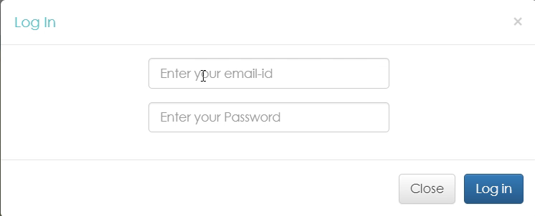
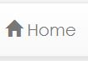
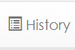

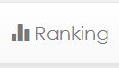

demo
used tech
Home Button
History Tab
support
admin
features
future scope
students
about
Here students can take the assignments or quizzes assigned by the teacher. The results will be calculated by the system.
Students can view the history of solved tests along with the scores and other details.
Ranking View
The website also provides the rank of the student with respect to the other students who undertook the test along with their respective scores.
Notes:
( Read before reading ppt while the video plays)
The users can select the type of login to the system either as admin or normal users using valid username and password. Students can sign in as user and prompt the system to carry out various tasks using the following buttons. ( Click to show buttons )

Slide 5
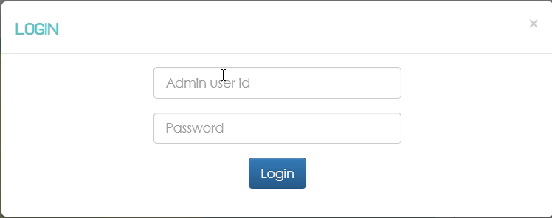
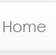
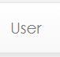
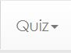
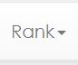
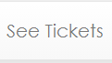


Home Button
User Button
The button allows teachers to view the topics of different quizzes created and related information.
Here teachers can view the details of students present.
demo
used tech
support
admin
students
features
future scope
about
Quiz Tab
Here teachers can :
Add a new quiz
Remove existing quiz
Rank Tab
Tickets Tab
The tab has two options :
To display the ranks of students as a list
To display the ranks of student as a chart
The tab allows teachers to view and edit the feedback given to the students.
Notes:
( Read before reading ppt while the video plays )
Similarly, teachers or lecturers can sign in as admin as shown. The tasks that can be done are: ( Click to show buttons )

Slide 6
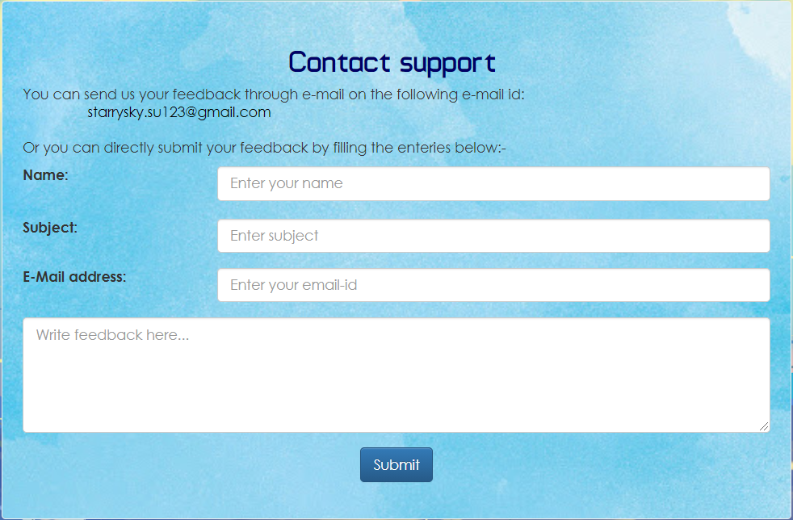
Feedback
More Info
Conditions and Privacy
Here users can provide feedback to the developers regarding their experience or to any issues occurred.
Users can know more about the team of developers to contact them.
Provide the terms all users need to abide with, and legal policies that handles user data.
demo
used tech
support
admin
students
features
future scope
about
Notes:
( Read before ppt )
The team also provides continual information and support system which will ensure customer satisfaction and improve the quality of the functioning. All users will be able to provide feedback and go through the legal policies of cookies collected. The tabs are : ( read ppt )

Slide 7
demo
used tech
support
admin
students
features
future scope
about
Front End
Back End
HTML ( Hyper Text Markup Language )
CSS ( Cascading Style Sheets )
PHP ( Hypertext Preprocessor )
MySQL
JavaScript
jQuery
Notes:
For developing the client side, the team has used HTML to structure and present the website content on the World Wide Web. CSS is used to describe the presentation of the document which includes various layouts, fonts and colors. For the web development of server side, PHP along with MySQL is used. .JavaScript along with the jQuery library has been used on the server end to make the web page more interactive.

Slide 8



01
02
03
demo
used tech
features
admin
about
future scope
students
support
GRAMMARLY
TURNITIN
ONLINE CLASSES
Integrate Grammarly API to search for grammar, spelling, punctuation and other mistakes in assignments to mark accordingly.
Integrate Turnitin API to
check plagiarism and to
ensure appropriate citation and referencing techniques.
Enable students to attend live and recorded online classes with improved security and quality features.
Notes:
( Before ppt )
In future circumstances the website can be also equipped with additional facilities to improve productivity. Some of these are : ( read ppt )

Slide 9
demo
used tech
support
admin
students
features
future scope
about
Notes:
Now one of our team members will demonstrate the website.

